Slide 1
Digital Portfolio
STUDENT NAME: k.yamini
REGISTER NO AND NMID: asunm1301222404474
DEPARTMENT: COMPUTER SCIENCE
COLLEGE: AM JAIN COLLEGE/ UNIVERSITY OF MADRAS

Slide 2
PROJECT TITLE
STUDENT PORTFOLIO

Slide 3


AGENDA
Problem Statement
Project Overview
End Users
Tools and Technologies
Portfolio design and Layout
Features and Functionality
Results and Screenshots
Conclusion
Github Link
3/21/2024 Annual Review

Slide 4

PROBLEM STATEMENT
Identifying the Gap
Freshers and students often struggle to present their skills and projects professionally.
Traditional resumes lack interactivity and may not reflect a candidate’s tech creativity.
Recruiters often don’t have time to read lengthy resumes.
Need for a Solution
A portfolio website provides a dynamic and personalized way to
showcase:
Technical skills
Real-time projects
Self-learning efforts
Design thinking and presentation ability

Slide 5

PROJECT OVERVIEW
Purpose:
To build an interactive, online portfolio that acts as a digital resume.
To reflect my journey, projects, and learning in a structured, professional format.
Key Objectives:
Make it simple, modern, and informative
Deploy the site online using GitHub Pages
Present a project-centric and skill-oriented identity

Slide 6

WHO ARE THE END USERS?
1. RECRUITERS/EMPLOYES :
Review skills and project work during hiring process
Evaluate both technical and design knowledge
2. PEERS AND MENTORS :
Provide feedback
Collaborate on open-source or academic projects
3.ACADAMIC INSTRUCTORS :
Assess practical implementation of skills
Validate course outcomes
4. PERSONAL USE:
Track career progress
Keep all achievements and work in one place

Slide 7

TOOLS AND TECHNIQUES
TECHNOLOGIES :
Frontend Languages: HTML5, CSS3
Programming Languages: Java, Python (used in projects)
Design: CSS Flexbox & Grid for layout, Google Fonts for typography
DEVELOPMENT TOOLS :
VS Code: Main code editor
Git & GitHub: Version control and collaboration
GitHub Pages: For free and reliable website hosting
BEST PRATICES FOLLOWED :
Clean code structure
Mobile responsiveness
Semantic HTML for accessibility

Slide 8
POTFOLIO DESIGN AND LAYOUT
DESIGN PRINCIPLES:
Minimalistic UI: Focus on readability and user experience
Consistent Layout: Uniform margins, font sizes, and color schemes
Sectional Division: Each section is clearly marked (About, Skills, Projects)
COLOR SCHEME & FONTS:
Primary Color: Light blue – indicates trust and calmness
Secondary Color: White – clean background for readability
Typography: Clean sans-serif fonts for modern appearance
RESPONSIVENESS:
Designed to adapt to different screen sizes (mobile, tablet, desktop)
8

Slide 9
FEATURES AND FUNCTIONALITY
CORE FEATURES:
About Me Section: Personal introduction and motivation
Skills Section: Represented as interactive tags (Java, Python, CSS)
Projects Section: Project titles and descriptions displayed neatly
Navigation: Smooth scroll and clear flow of content
EXTRA FUNCTIONALITIES:
Mobile Friendly: Works on smartphones and tablets
Fast Loading: No backend or heavy libraries
Version Controlled: Easy to update and maintain via GitHub

Slide 10
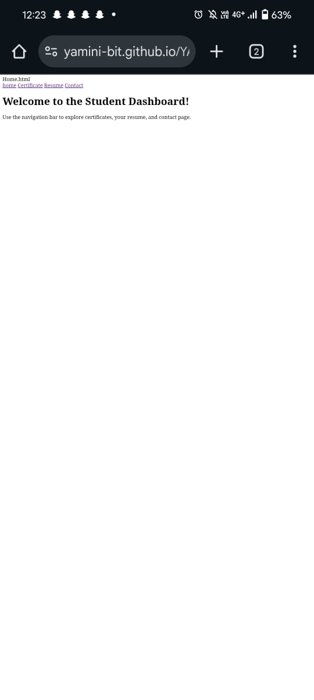
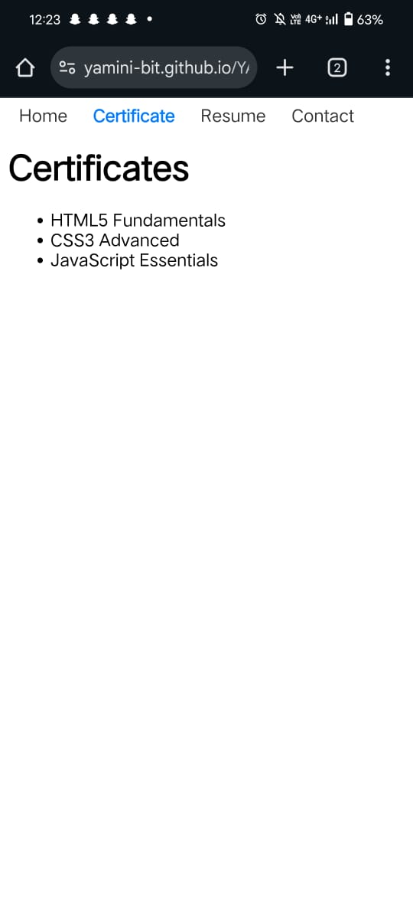
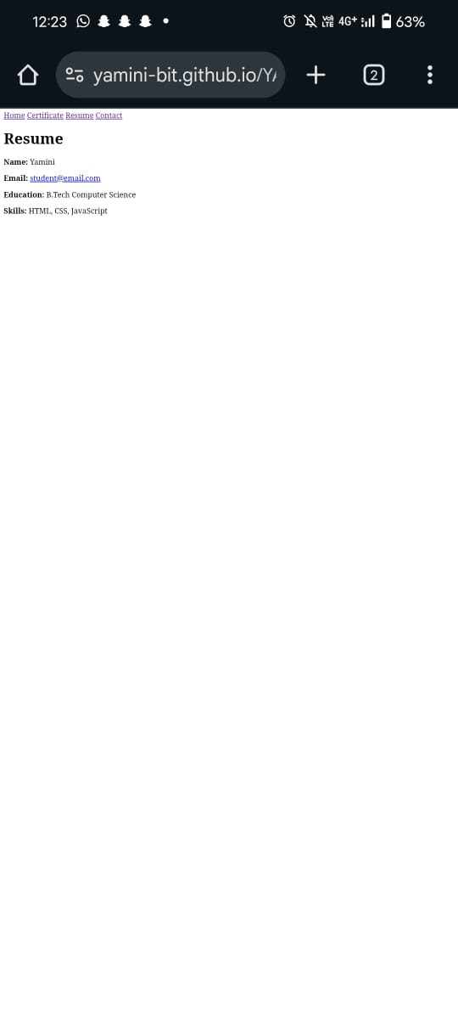
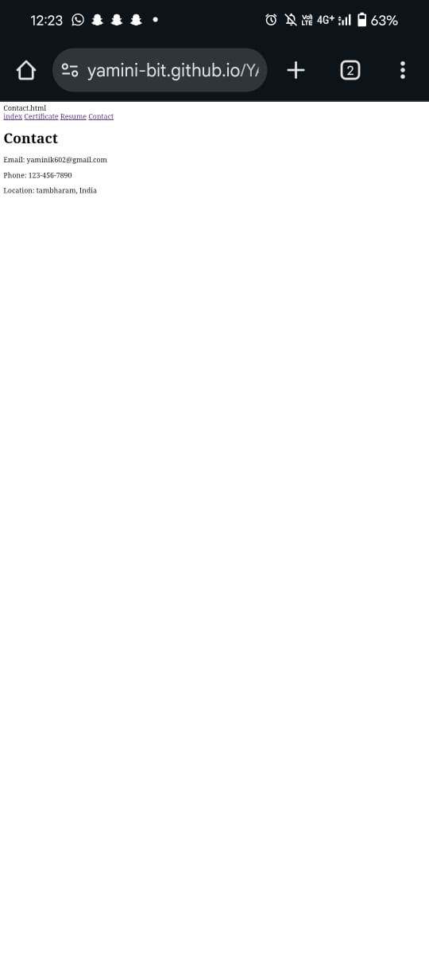

RESULTS AND SCREENSHOTS
3/21/2024 Annual Review
10

Slide 11
CONCLUSION
IMPACT :
A personal portfolio helps in standing out from the crowd in technical interviews
Reflects professionalism, consistency, and strong communication
FUTURE SCOPE :
Add blog section to document learning
Integrate contact form or links to LinkedIn/GitHub
Include more projects with live demos and GitHub links
11

